Slide 1
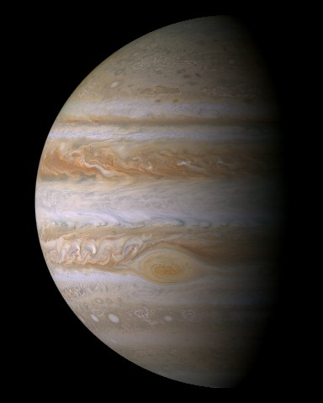
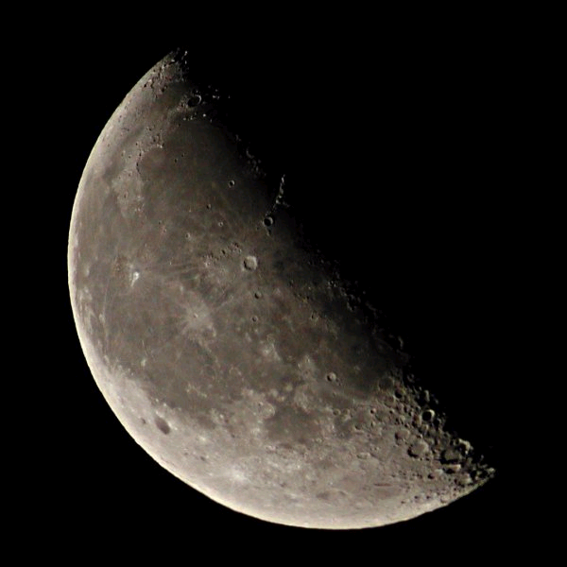
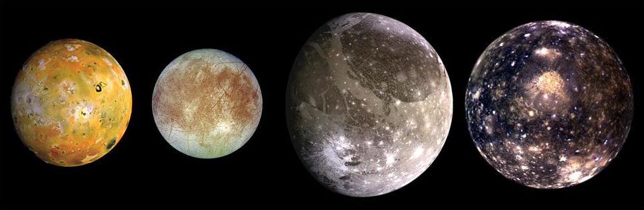
Gazing at Jupiter and the Moon
Maria on the Moon

Slide 2
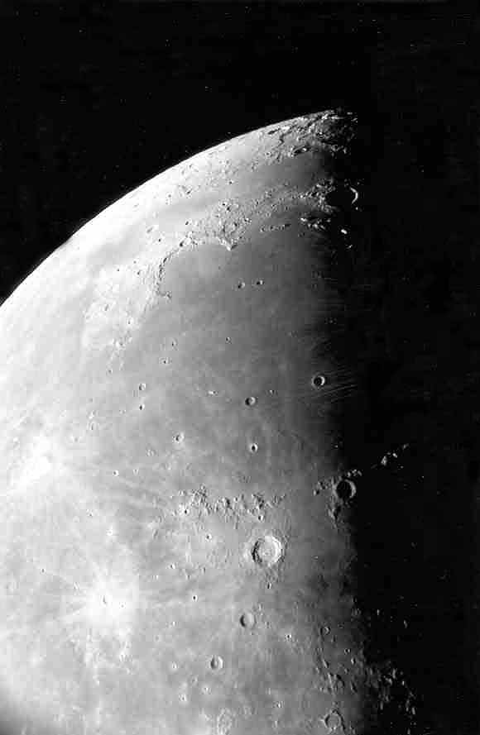
Moon maria as seen through the telescope.
Photo by Jim Fullerton

Slide 3
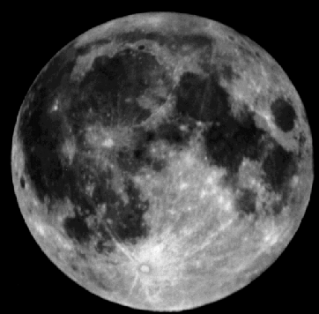
The maria (maré) are the smooth dark areas on the surface of the Moon.
Maré
Highlands

Slide 4
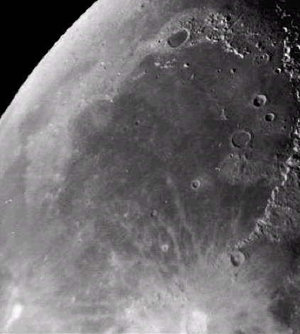
The maria were formed about 3.5 – 4 billion years ago.
Mare Imbrium
Lava flowed through cracks in the lunar surface and filled in low laying areas.

Slide 5
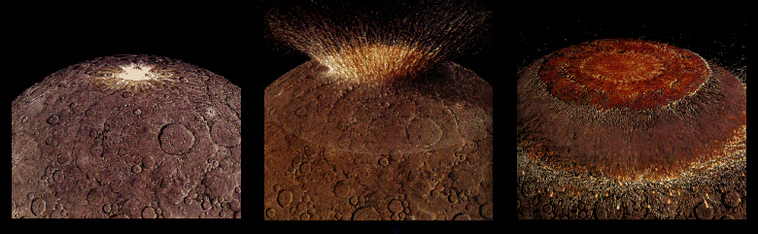
Four billion years ago the impact of a large asteroid forms a huge multi-ringed basin which thinned and fractured the lunar crust.

Slide 6
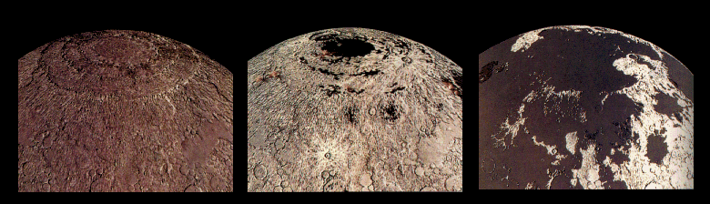
Fluid lavas from beneath the moon’s crust erupt and flood across the low regions of the lunar surface – covering many craters.

Slide 7
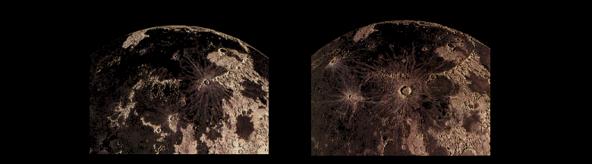
Less than a billion years after they began, the lavas cease erupting on the Moon. Occasional craters form on top of the maria.

Slide 8
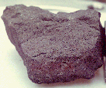
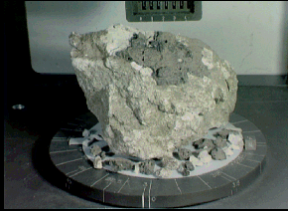
Lunar rock samples from the moon’s maria are dark colored rocks.
Samples from the highland regions are much lighter in color.

Slide 9
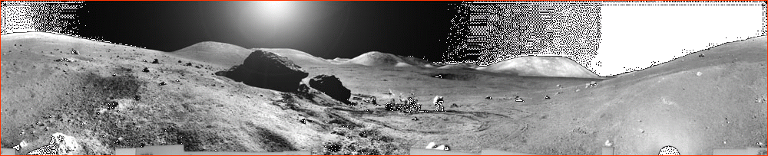
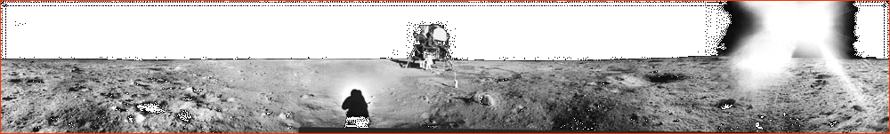
One of these shows the lunar surface from a mare and the other, the highlands.
Can you tell which is which?

Slide 10
The highlands are rugged.
The mare are smooth & flat.

